Slide 1
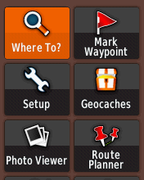
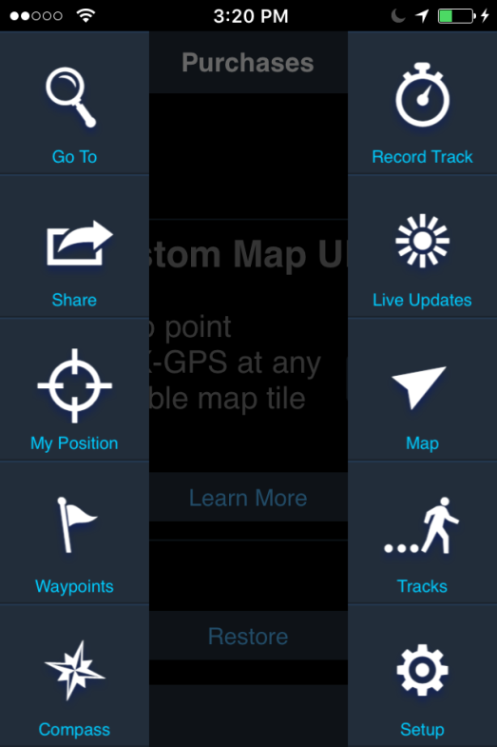
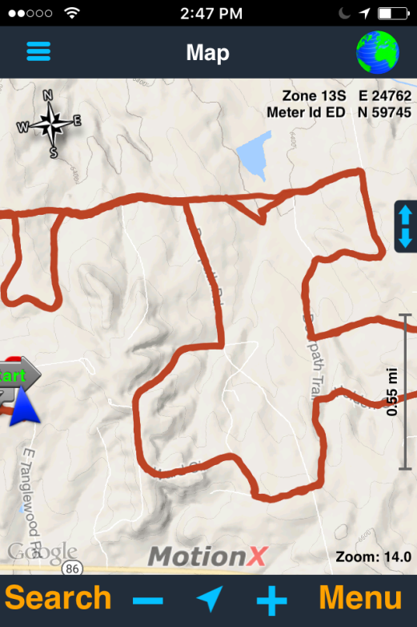
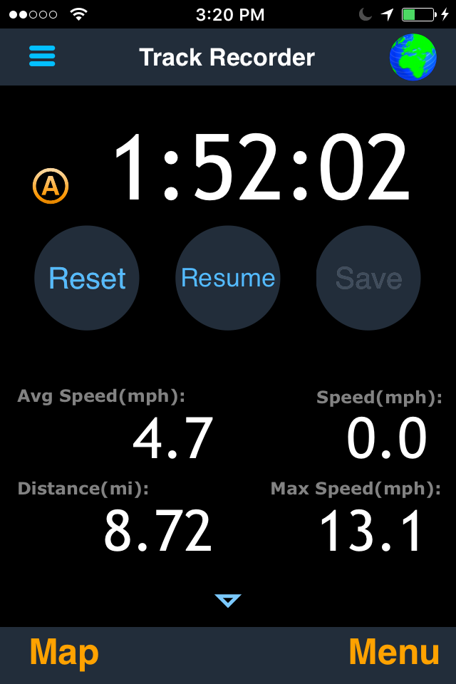
Timing Out
Press Menu button.
Press Record Tracks button.
Press Reset button.
When you are ready to time out, select “Reset.” The time, distance, and speed
will reset to zero. To see the map, press the map button.

Slide 2
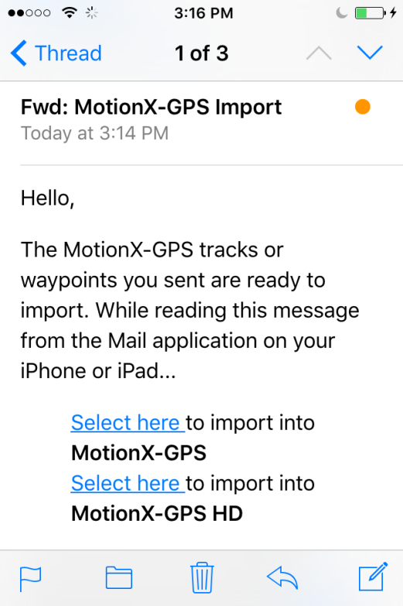
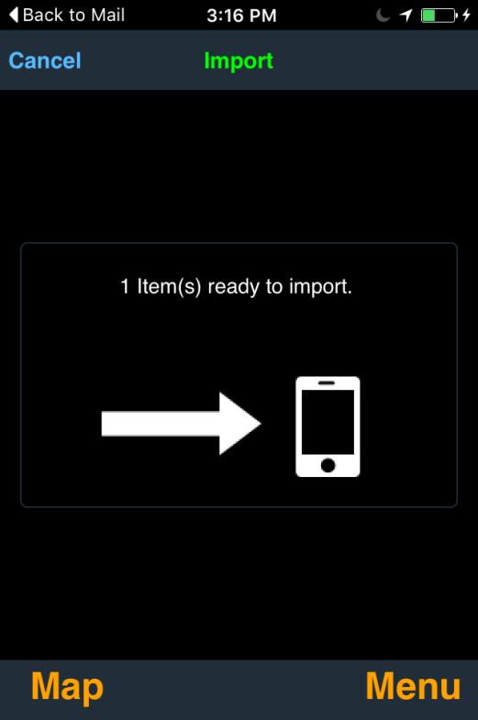
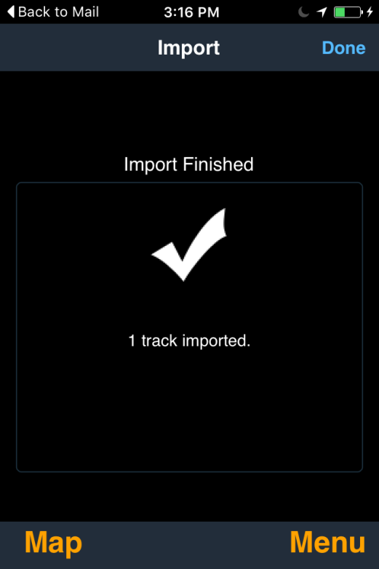
Load an E-Mailed GPX Track onto Phone
Open e-mail message and click on “Select Here.”
Confirm file data and click “Import.”

Slide 3
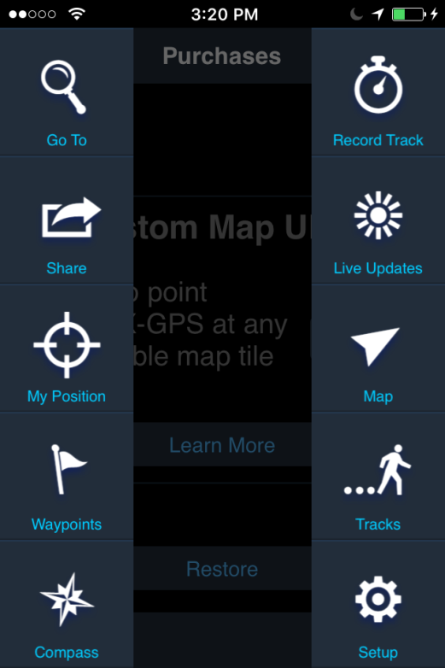
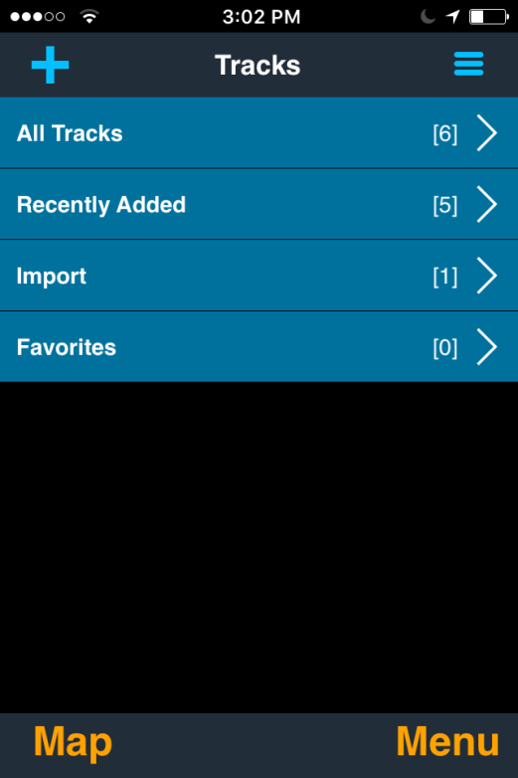
Loading a Saved Track
Press “Menu.”
Press “Tracks.”
Press “All Tracks.”

Slide 4
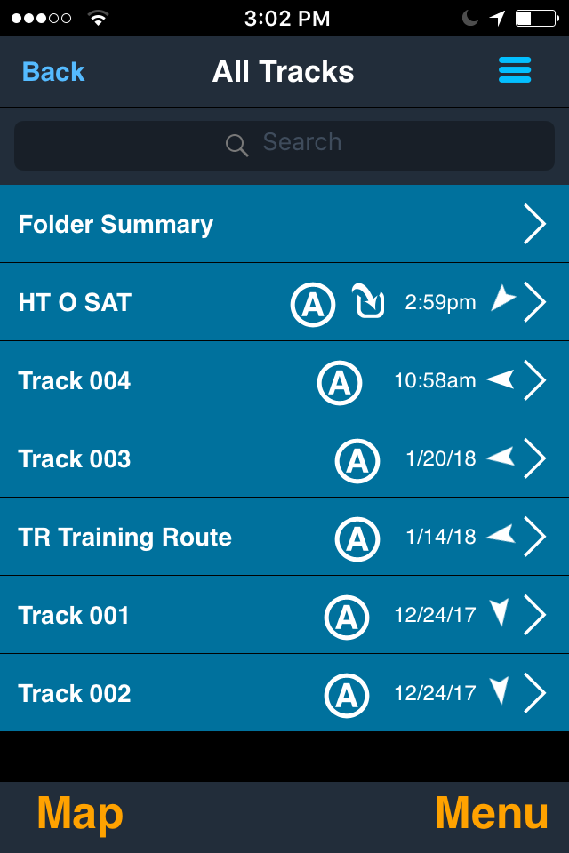
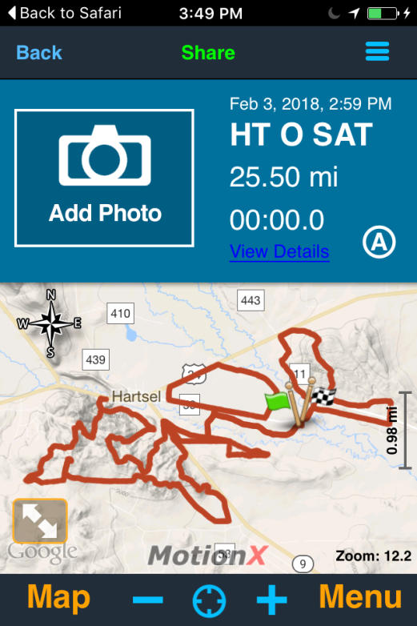
Loading a Saved Track (cont.)
Select desired track.
Loaded onto phone.

Slide 5
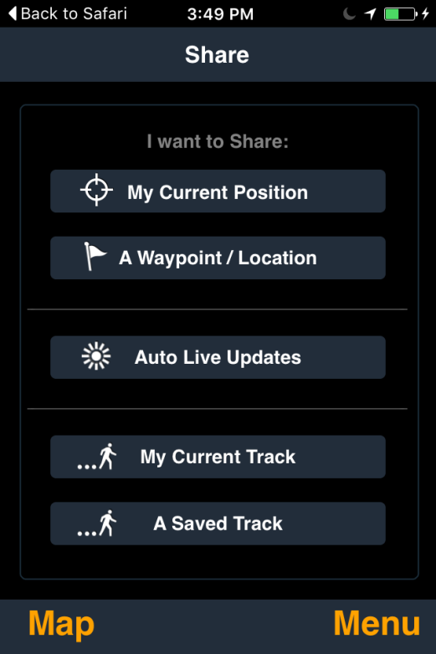
Sharing a Recorded Track
Press “Menu.”
Press “Share.”
Press “a Saved Track.”

Slide 6
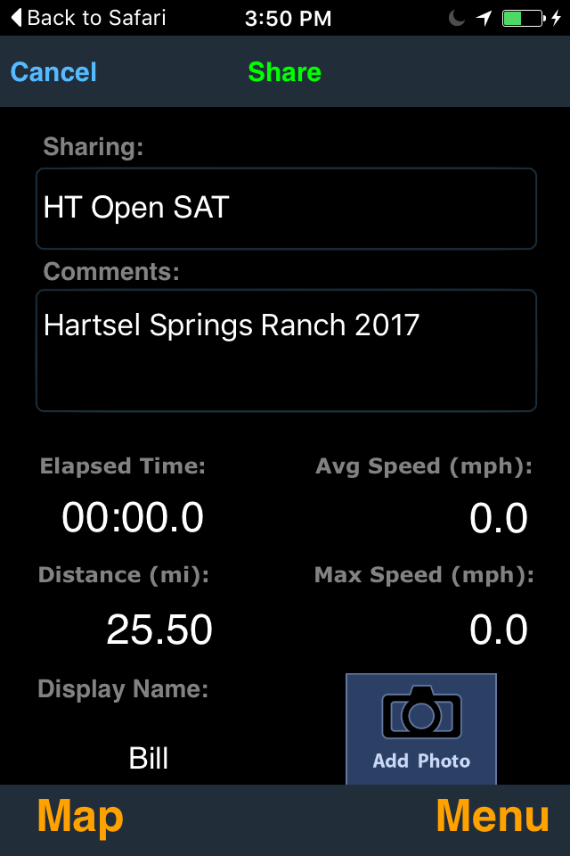
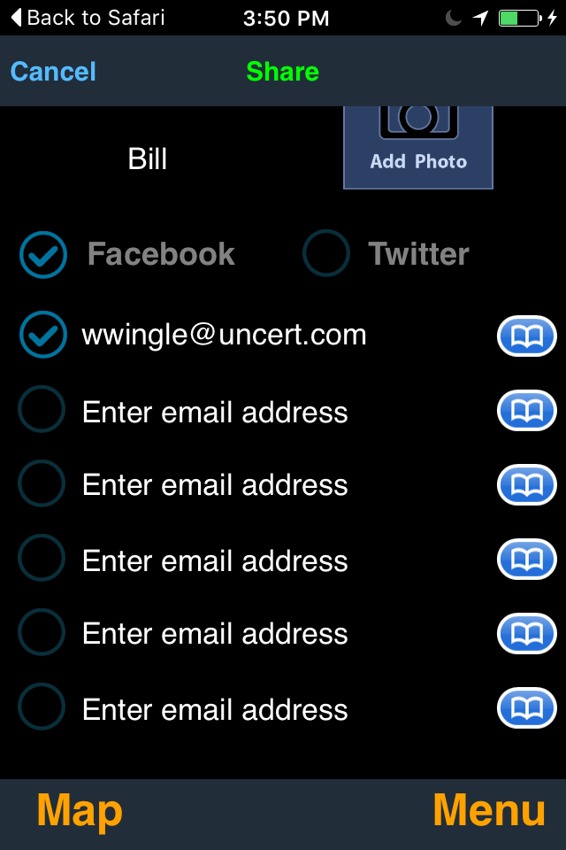
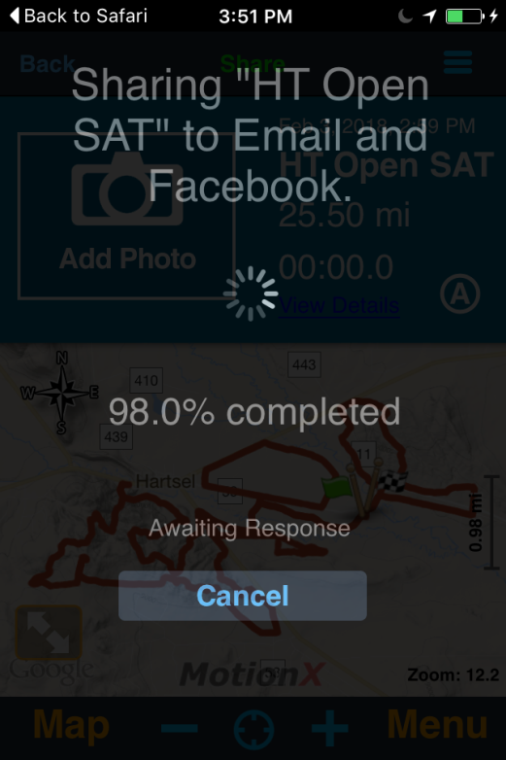
Sharing a Recorded Track (cont.)
Fill out information and press “Share.”
Select share methods and press “Share.”.
Confirm “Share” completes.
WARNING: When saving to Facebook, it had it fail for a large GPX file. Smaller files worked fine. E-mailing the larger files worked fine.

Slide 7
Sharing an Track Not Loaded in MotionX
If you have edited or created a GPX track somewhere else, not in MotionX, you can still send it to MotionX app users, but it is a two step process:
E-mail your GPX file to GPSimport@motionx.com. MotionX will store the file on their servers, and auto-reply to you with a link to you GPX file.
When you get the reply, forward that message to you MotionX users. When they get the message and click on the link, they will download your GPX file (see slide #2 above).

