Slide 1
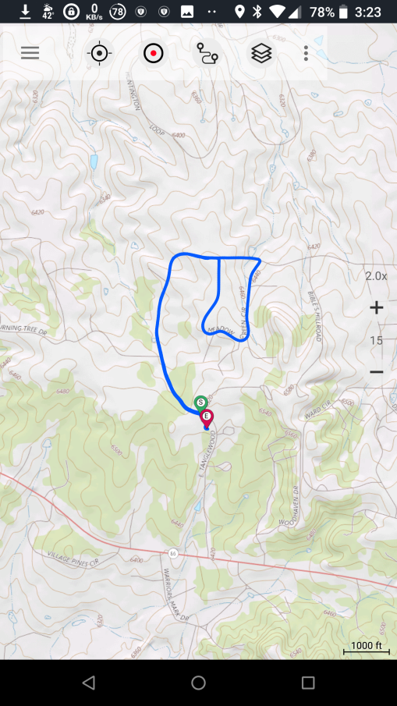
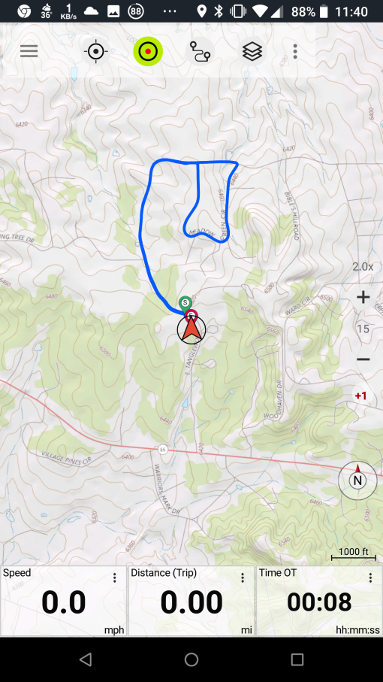
Timing Out
Press “red dot” button to start.
At end of day, press “red dot” button again to stop logging the track.
If you accidentally hit the “red dot” button during the ride, do not hit “Discard” or “Save.” Tap anywhere outside the Save dialog.
When you are ready to time out, select “Reset.” The time, distance, and speed
will reset to zero. To see the map, press the map button.

Slide 2
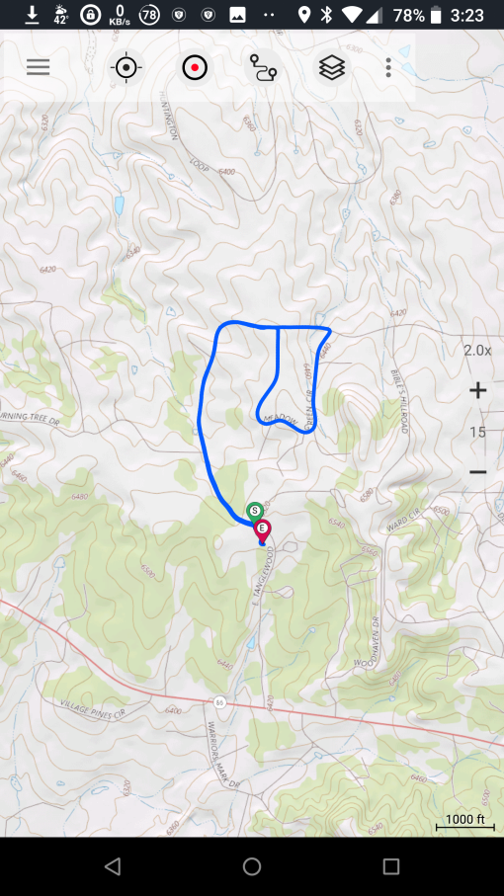
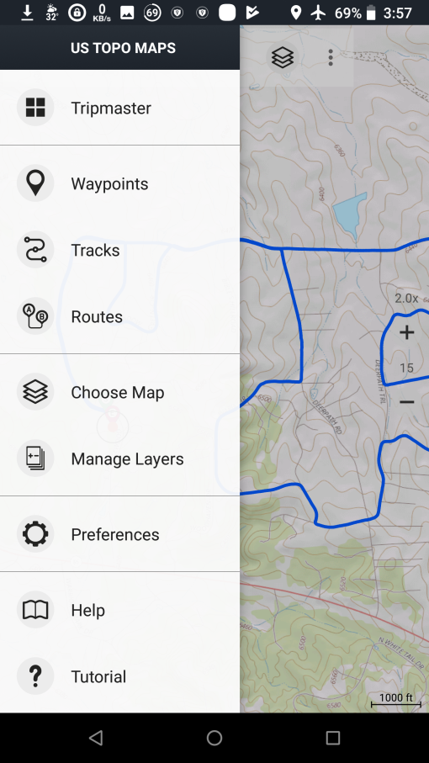
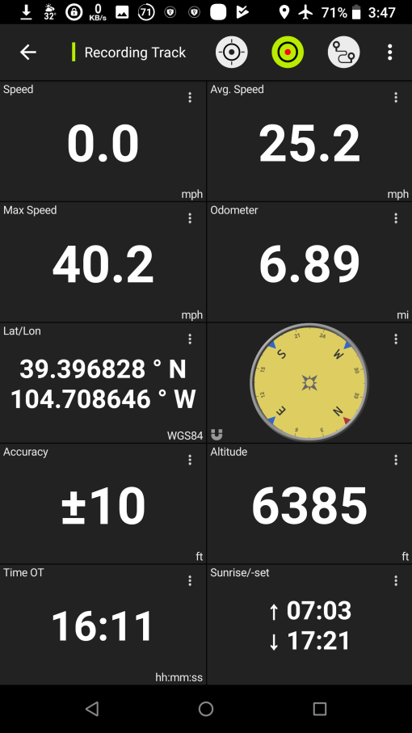
Show Detailed Trip Information
Click “Menu.”
Press “Tripmaster”.

Slide 3
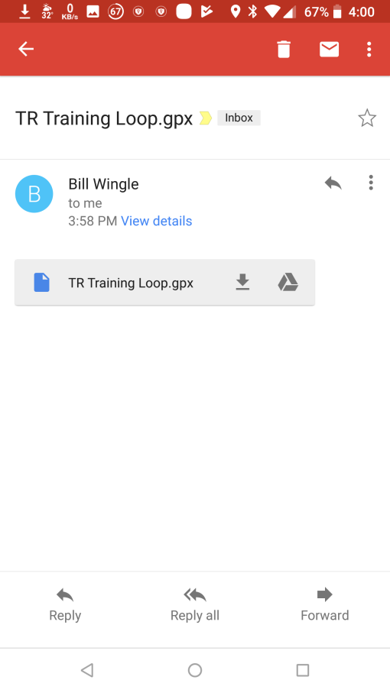
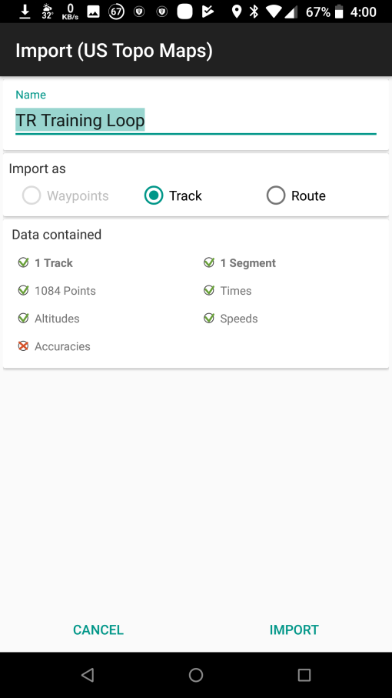
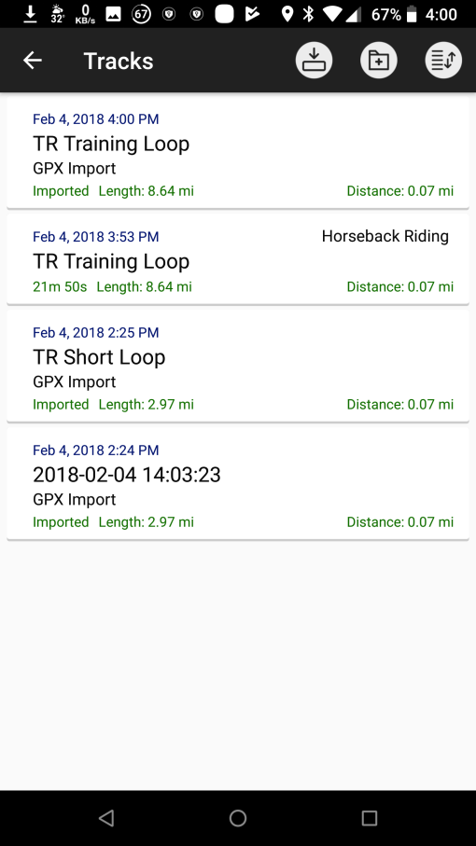
Load an E-Mailed GPX Track onto Phone
Open e-mail message and click on name of GPX file (not download arrow).
Confirm file data and click “Import.”

Slide 4
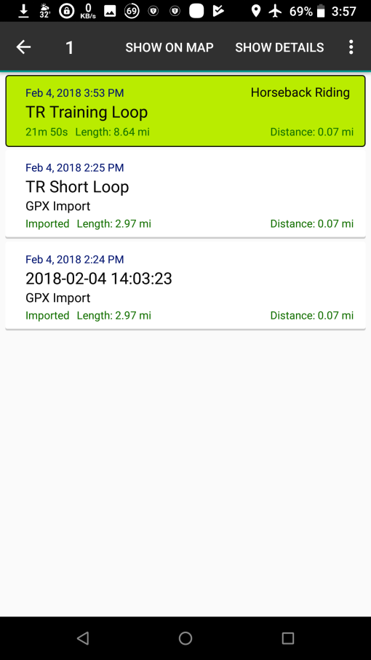
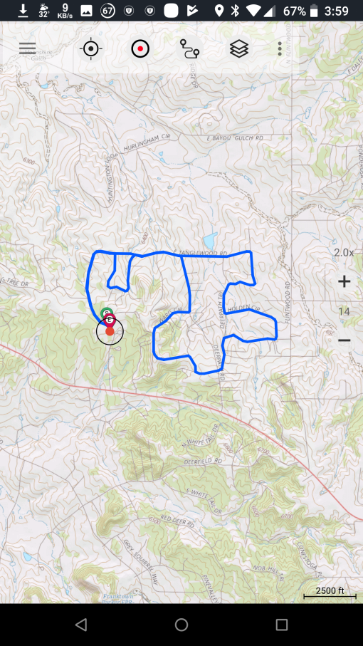
Loading a Saved Track
Press “Tracks”.
Select the desired track, then press “SHOW ON MAP.”

Slide 5
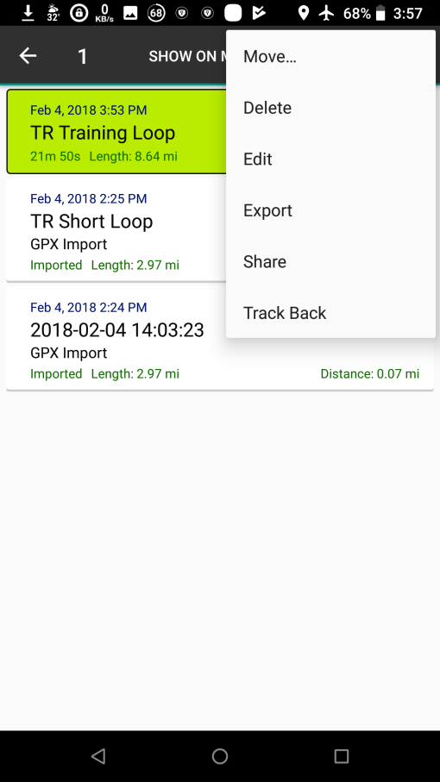
Saving a Recorded Track
Press “Tracks.”
Select the desired track, then press 3 vertical dots.
Press “Share.”

Slide 6
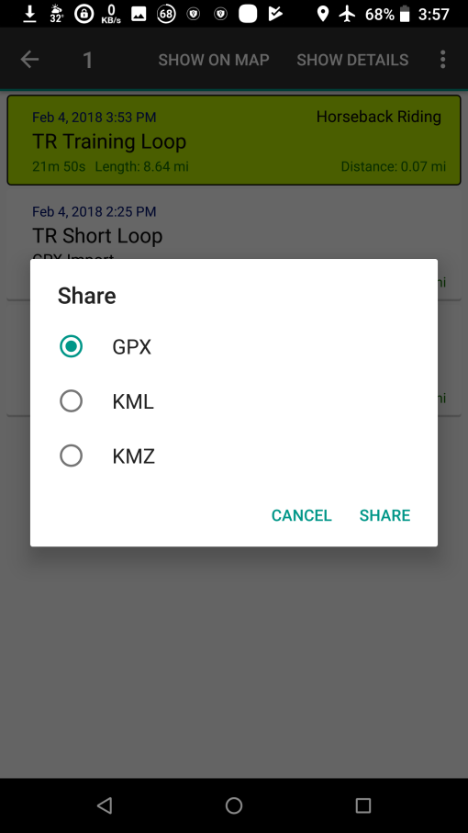
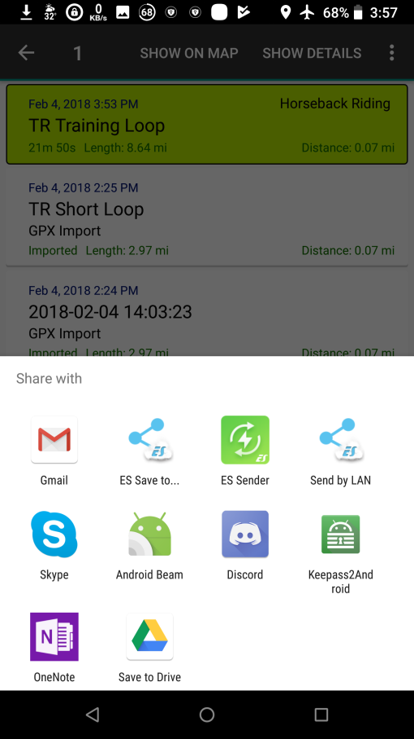
Saving a Recorded Track (cont.)
Press “GPX”, then click “Share.”
Select “Gmail” and send the track.
NOTE: When sending a GPX file to others, no special steps are need other than sending the GPX file to an account accessible on the persons smartphone.

