Slide 1
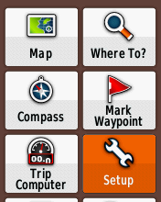
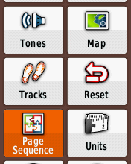
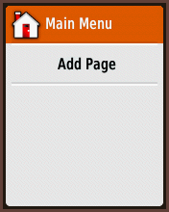
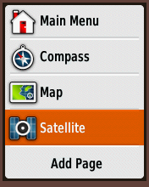
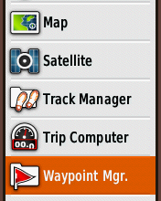
Setup screen pages
Press “Add Page”
The Garmin will show you a list of screens.
I like the following.
Map and Trip Computer are the most important.
Pressing the “back” button (top right), you can quickly cycle between these different pages.

Slide 2
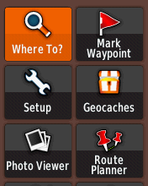
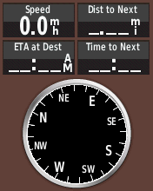
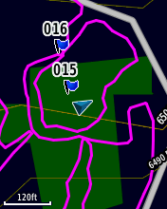
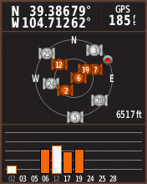
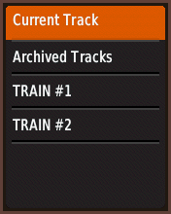
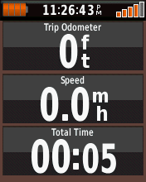
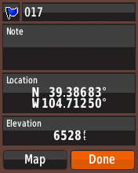
Cycle through GPS screens
Once the pages are setup, pressing the “back” button” (top right) will cycle you
though the different pages
Main Menu
Compass
Map
Satellite
Track Manager
Trip Computer
Waypoint Mgr.

Slide 3
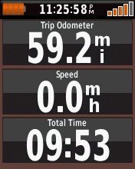
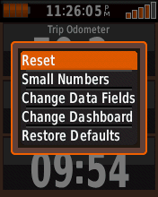
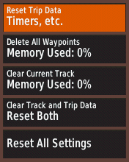
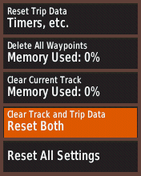
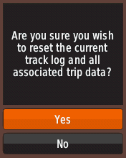
Timing Out
Press “Menu” button. Bottom left button.
The Garmin will show you a list of screens.
Press straight in on “toggle” button on GPS face to select Reset options.
If you save breadcrumb data, ONLY “Reset Trip Data.”
Select …
When you are ready to time out, select “Yes.” Press the Back button (top right)
once and you will see a screen with all the trip computer information reset.

Slide 4
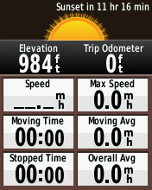
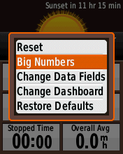
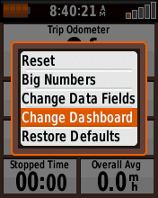
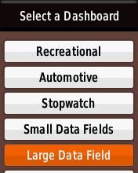
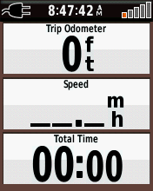
Setup trip computer screen
Press the “back” button” (top right) until you get to the trip computer page:
Press “Menu” button (middle of left side – bottom button)
I like big number on my screen.

Slide 5
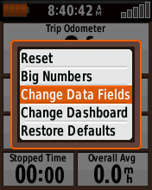
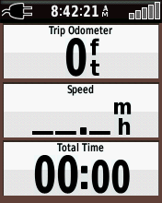
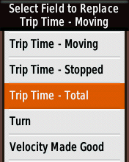
Setup trip computer screen (cont.)
Change bottom display field from “Moving Time” to “Total Time.”

Slide 6
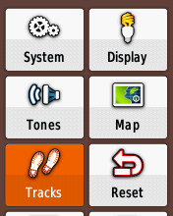
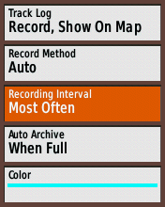
Setup breadcrumb tracking detail
Change “Recording Interval” to “Most Often”

